Slide 1
MDI Kickoff
Internal name - “Million Dollar Idea”
External name - Media Device Interface

Slide 2
Goal
Pursue an idea that will crowdsource into the hundreds of thousands of dollars or more
  A more practical version of Jibo
    The best Jobo feature is the autonomous camera
  Kickstarter or Indigogo?

Slide 3
Concept
Semi-Autonomous Camera
Fixed location (typically, countertop, coffee tabletop)
Mode selection from mobile device
Able to take pictures/movies
Able to track selected objects

Slide 4
Semi-Autonomous
Grandpa's hands free Christmas
Can take pictures on it's own
Can track people in a room
Set it and forget it camera

Slide 5
Camera Features
Single snapshot
Video Camera
Periodic snapshots

Slide 6
Fixed Location
180 degree rotation (pan)
Can be tilted -X deg, +y deg

Slide 7
Mode Selection
Mobile device can control the camera's operation/modes
Face selection/training

Slide 8
Camera Modes
Single snapshot – like camera remote or timer
Periodic snapshots
Video Camera operation

Slide 9
Camera Tracking
Select individuals to track

Slide 10
Hardware
Connected Device
Camera that can do snapshots or continuous video
Enough processing power to serve up mobile screens and store data
Store to a USB thumb drive?

Slide 11
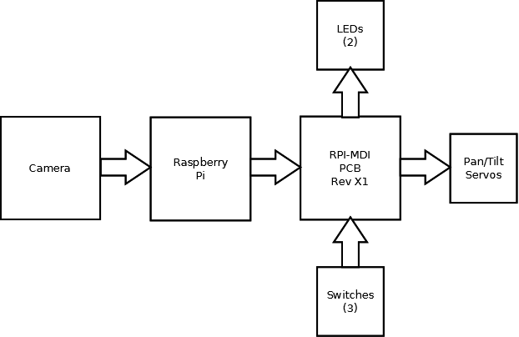
Prototype Block Diagram

Slide 12
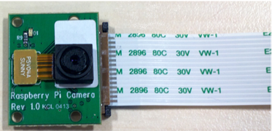
Camera
5 MP still camera
720p video
No microphone
Fixed focal length
Low light performance?

Slide 13
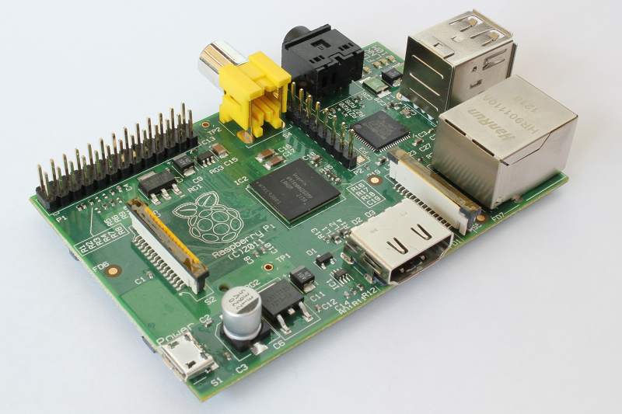
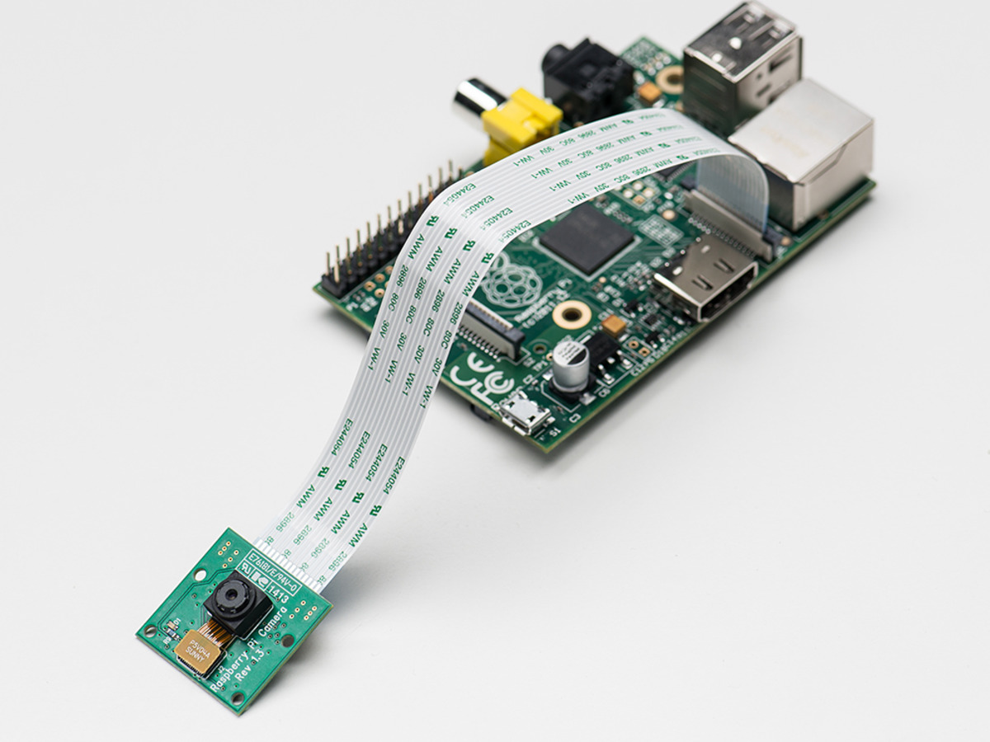
Raspberry Pi
Either Model B or Model B+
USB port for memory stick
Network wireless dongle
Camera Interface
Support daughtercards

Slide 14
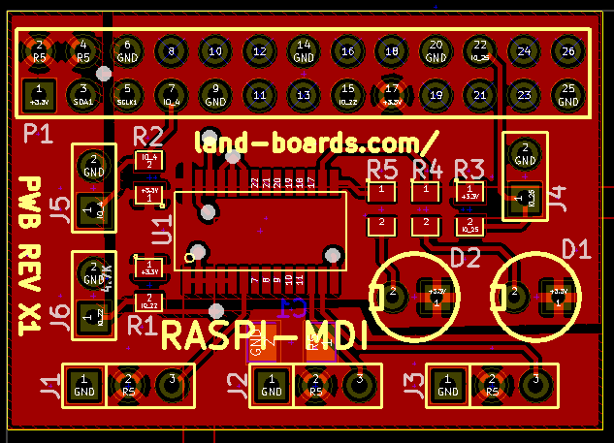
RPI-MDI Board
Raspberry Pi Daughtercard
26-pin connector works with either Model B or B+
(3) Switch inputs
I2C PWM IC
(3) Servo outputs
(2) PWM LEDs
Missing microphone input for videos

Slide 15
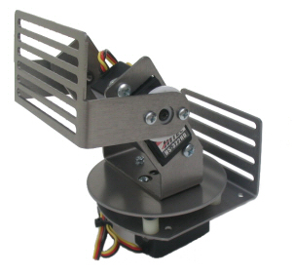
Pan/Tilt Mechanism
Uses 2 Servos one for pan and one for tilt
Fixed base
Rotates camera and Pi

Slide 16
Power System
AC Powered
DC Powered?
  Rechargeable
  LiPo – low self dischargr
  Power Budget
  Run time

Slide 17
Software Elements
RasPi running Raspian (Debian variant)
Enabled camera with raspi-config
raspi-still – takes a picture
raspi-vid – takes a .H264 format video
Adafruit Python PWM chip driver

Slide 18
PCB Tasks
Ordered PWB from OshPark
Estimated arrival 20-Oct-2014
Added PWM part to Mouser Project Manager/shopping cart
Build a couple of boards
  1 hardware prototype
  1 for software development (switches/LEDs, etc)

Slide 19
Mechanical Tasks
Assemble Pan/tilt mechanism
Get pan/tilt working with Arduino UNO?
3D print an enclosure?

Slide 20
Software Tasks
OpenCV?
Investigate face recognition software
Investigate tracking software
One Touch Network connection?

Slide 21
Other Tasks
Investigate what hardware is needed to add audio to the Raspberry Pi input
Can it run at the same time as the video without killing the video?
Bill of materials – costing

